Slide 1
Progres Tubes 1
Sistem Reservasi Klinik

Slide 2
Kelompok 2
Muhamad Rama Dewa Putra 2350081016
Asep Tatang 2350081030
Jibaal Zabani Priadi 2350081116
Alyani Kaila Nursiswandila 2350081044

Slide 3
Jobdesk
Front end
Back end
Database
Asep Tatang
Rama Dewa
Alyani Kaila
Jibal Zabani

Slide 4
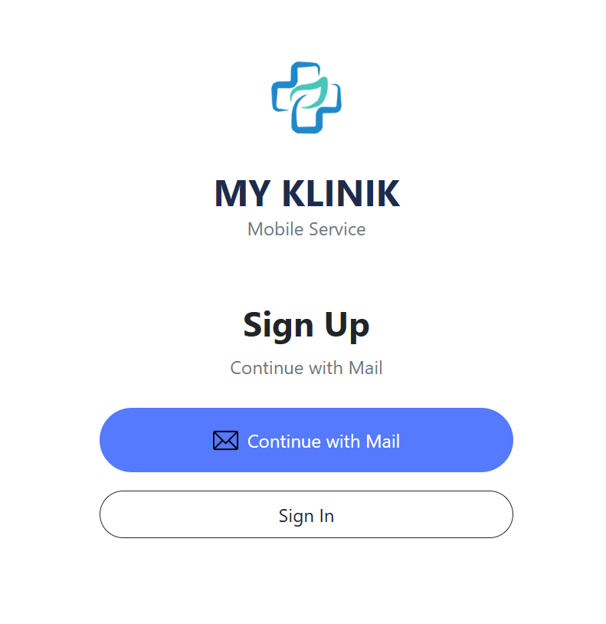
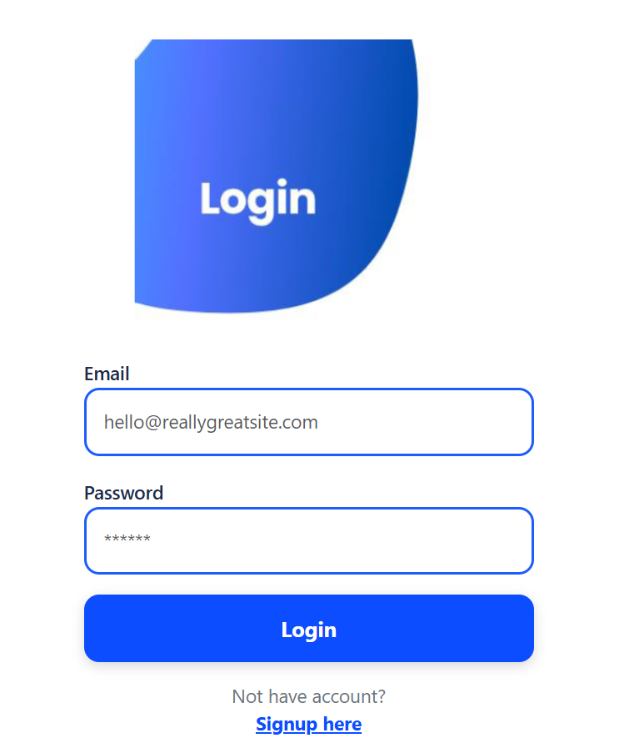
Progresan
Desain UI/UX

Slide 5
